Slide 1
Spring Update 4
Dev Bhatia
Ultrafast Optics Laboratory
Boston University

Slide 2
Temp Sensor Position
Varying the position of the temperature sensor with only water would lead to
the ability to more clearly define the media properties of water
Gain a perspective of the temperature transients as we go deeper within the medium
This is accomplished by altering the “model.HS.tempSensorPositions” field within the heat simulation

Slide 3
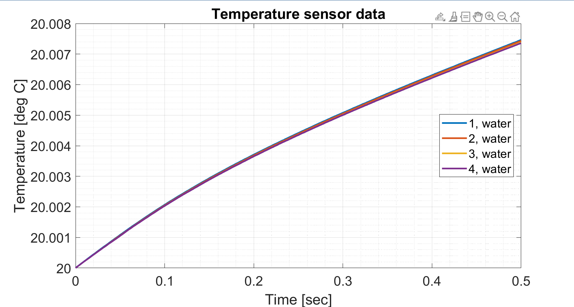
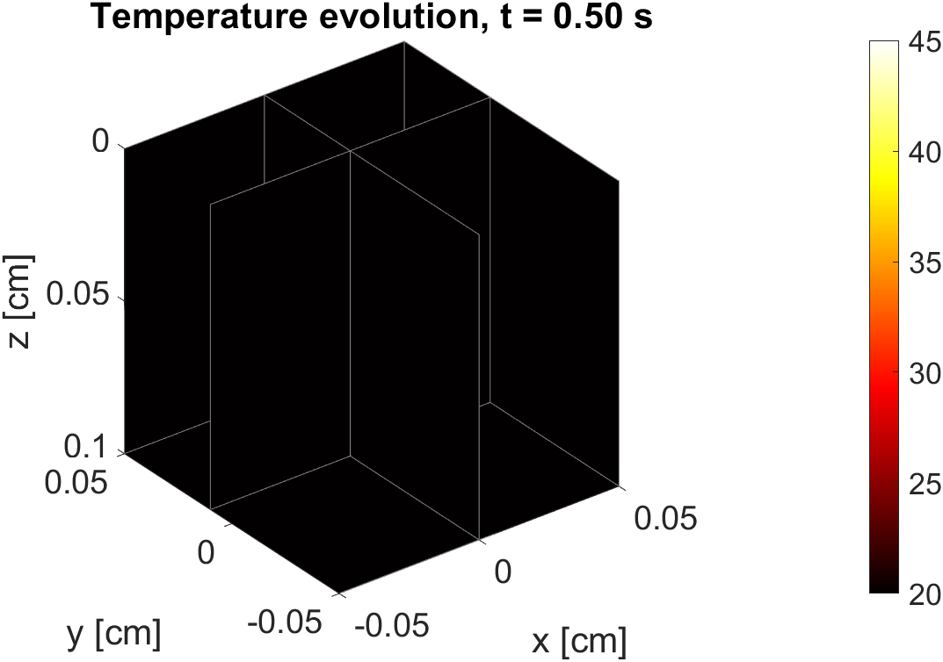
Temp Sensor Position (cont.)

Slide 4
Layering
We need to create multiple layers of media in order to implant a z-distance
“Air” would constitute the top layer
Adjusting the size of the air may be a pliable way to evaluate a z distance
This layering scheme would also allow for defining the volumetric heating capacity for the top layer of water

Slide 5
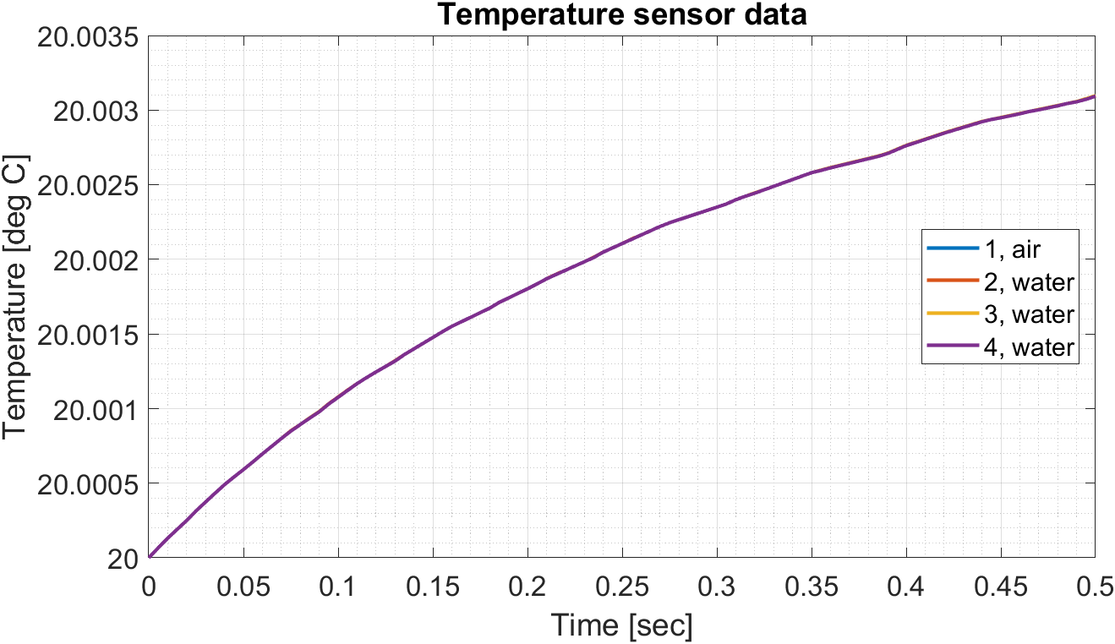
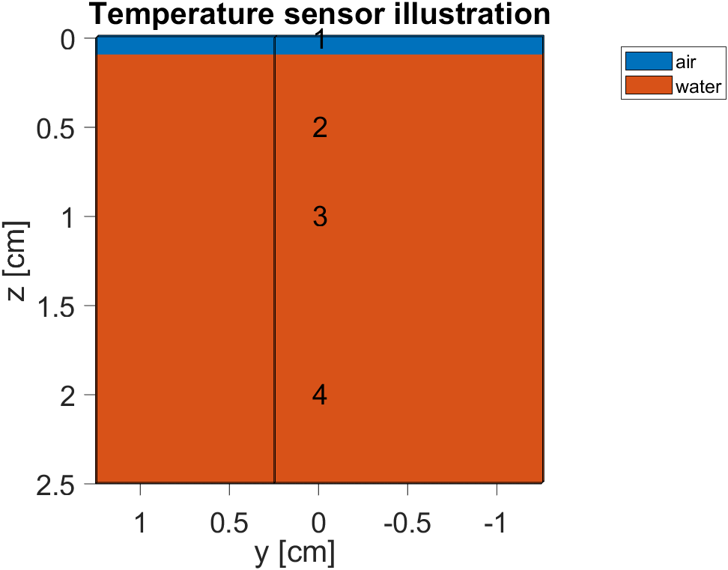
Layering cont.

Slide 6
Next Steps
Continue to modify the layering scheme
The introduction of a VHC would likely help with the inconsistency
Modify sensor position on the template files given
Would give an indication of best practices of doing do
Re-evaluate geometry of design

